Slide 1


capstone project phase A
Social network for healthy life
supervisor: Dr. Zakharia Frenkel
Group members: Reem Kadmany & Roaa Bader

Slide 2

Online Health community
Online chat groups in which people can share their experiences about a health topic and seek/provide support to the members in chat.

Slide 3
Motivation
Over time, online health communities become more massive. As a result, finding trustworthy information can take a lot of time and effort that's why we need a fast and reliable way to get trustworthy information.
Our project is a follow-up to another project that we will improve.
Quality
Service

Slide 4



OUR SOLUTION
A Social Network For Healthy Life

Slide 5

In our Social Network For Health Life a user can:
1
Join communities where each community has an admin and a moderator.
2
Share a medical experience he went through to help others.
3
Seek support from other members.
4
Attend online lectures.

Slide 6

In our Social Network For Health Life an expert can:
1
Share his knowledge and offer support.
2
Get more experience.
3
Recommend Products and Services.
4
Get more clients.

Slide 7
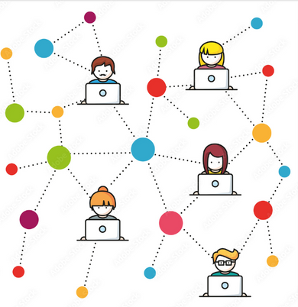



Features
Chat
Ranking system
Privacy
Service history

Slide 8
Features
Ranking system
Chat
Privacy
Service history

Slide 9
Features
Privacy
Chat
Ranking system
Service history

Slide 10
Features
Service history
Chat
Ranking system
Privacy

Slide 11




Features
Anonymous counseling
Online Lectures
Asking and
answering questions
File Directory

Slide 12
Features
Anonymous counseling
File Directory
Asking and
answering questions
Online Lectures

Slide 13
Features
Anonymous counseling
Asking and
answering questions
Online Lectures
File Directory

Slide 14
Features
Asking and
answering questions
Anonymous counseling
Online Lectures
File Directory

Slide 15


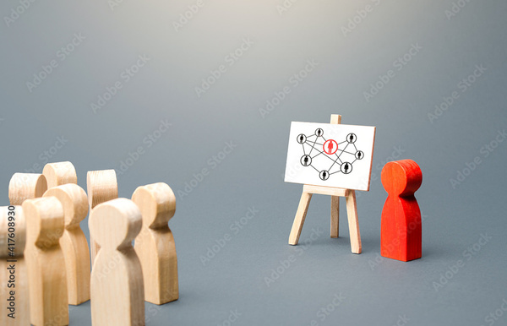
Meritocracy
A system where individual gain economic goods and political power based on their talent, effort, and achievements.
The only feasible approach to ensure quality of the community generated content.
Results-Based
Equal
Opportunity

Slide 16


ALGORITHMIC CHALLENGES

Slide 17

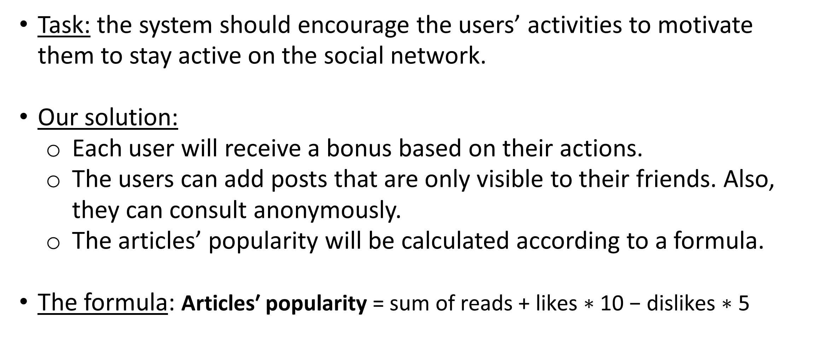
Awarding system
Task: the system should encourage the users’ activities to motivate them to stay active on the social network.
Our solution:
Each user will receive a bonus based on their actions.
The users can add posts that are only visible to their friends. Also, they can consult anonymously.
The articles’ popularity will be calculated according to a formula.
The formula: $\text{Articles}\text{′ }\text{popularity} \text{=} \text{sum} \text{of} \text{reads} \text{+} \text{likes} \text{∗} \text{10} \text{−} \text{dislikes} \text{∗} \text{5}$

Slide 18
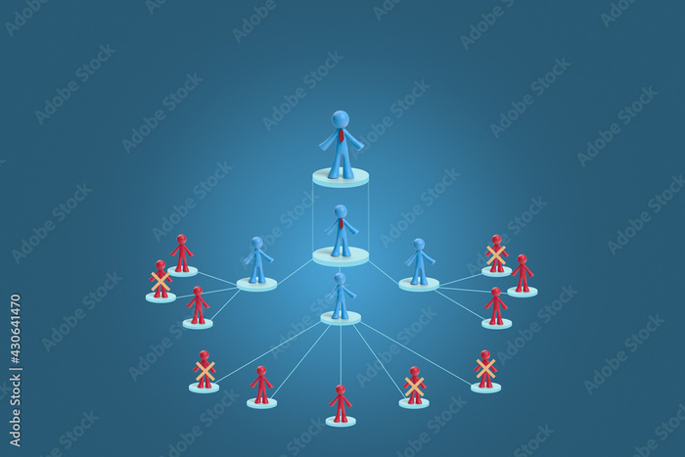
Providing the meritocracy
Task: readers should have the option to filter content based on its reliability.
Our solution: in our system, each community has an expert that is picked based on his talent and he will provide the reliability of content, while the moderator removes the irrelevant content.

Slide 19

Asking and answering questions
Task: answer optimal answers for a wide range of questions.
Our solution:
The user can estimate the answer he received based on its relevance.
Bonus for answering: to encourage the user to answer more questions he will gain a 30 points bonus for each answer. Furthermore, for a helpful answer, he will get 60 points extra.

Slide 20
Technology challenges
Performance: web applications need to be fast loading, responsive and reliable in order to meet the needs of today's online users.
User experience: building products that are useful, easy, and enjoyable for people to use.
Security: should be considered in each stage of the software development life cycle, especially when the website is dealing with essential information such as medical care data.

Slide 21
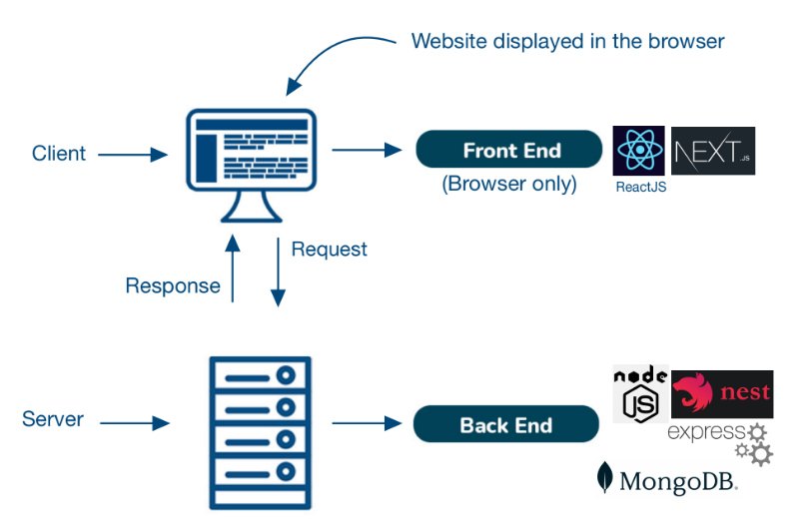
Algorithm
Technologies

Slide 22




Constraints
NestJs
NextJs
React
MongoDB

Slide 23
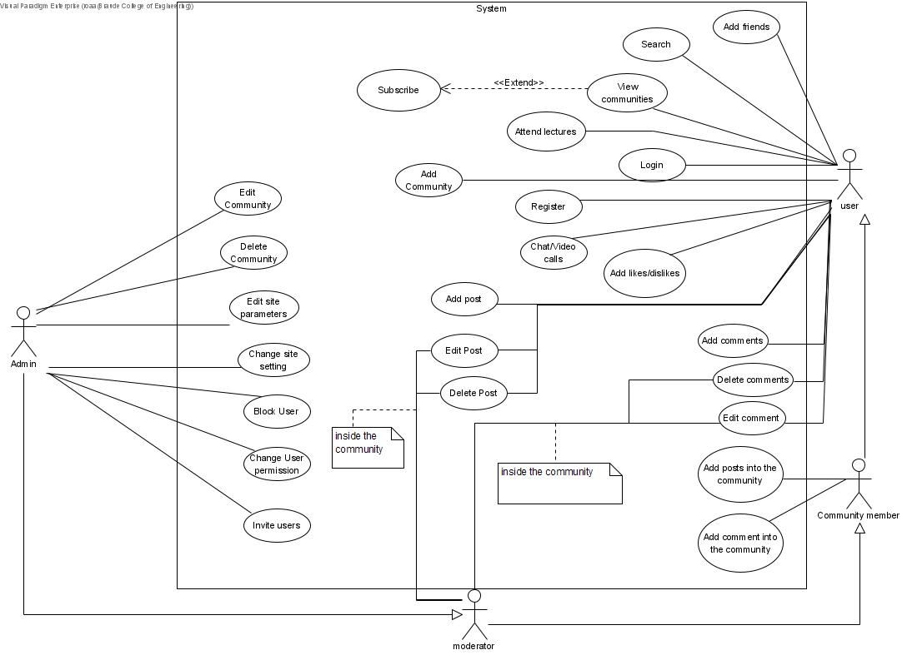
Use Case

Slide 24
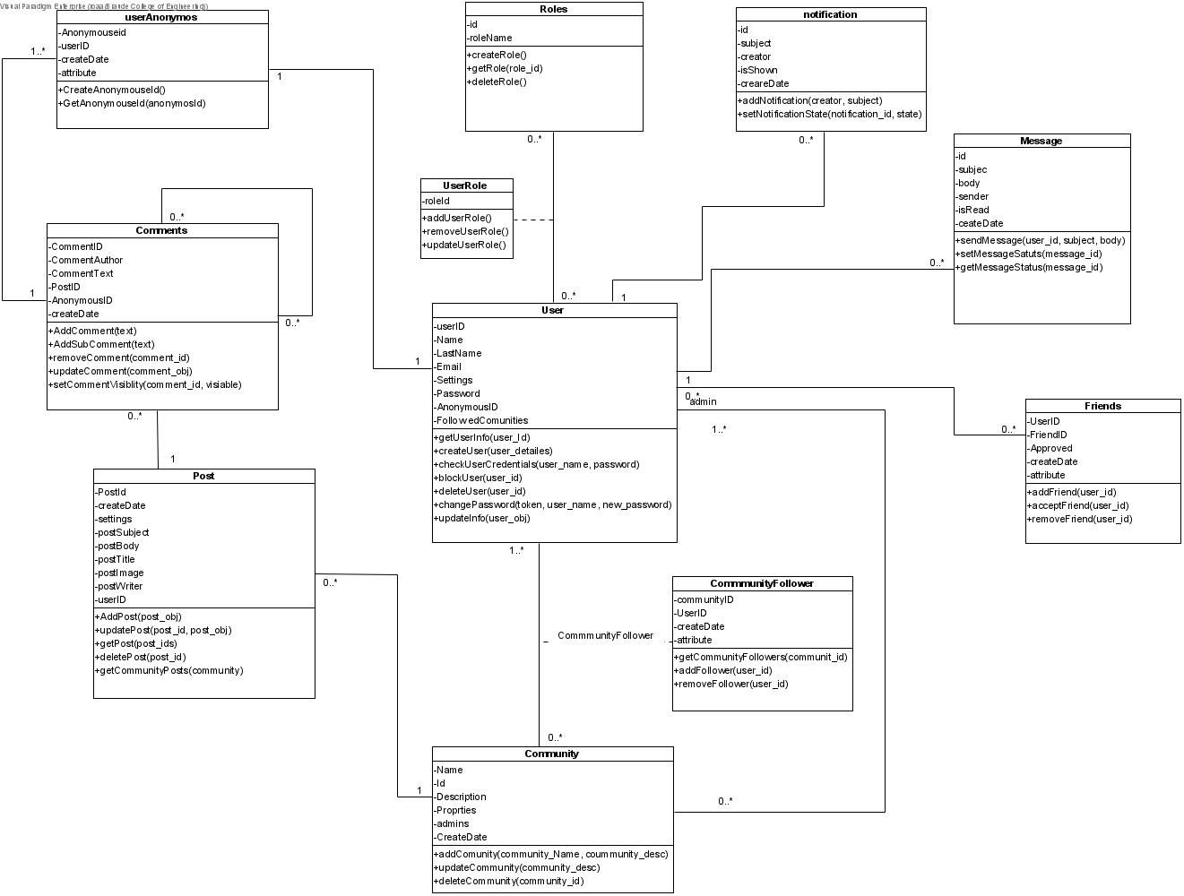
Class diagram

Slide 25
Our website has several interfaces:
User
Community Member
Moderator
Admin
Add/chat with friends
View/create new communities
Attend lectures
Add, delete and edit posts/ comments
Add posts/ comments to the community
Delete and edit posts
Delete and edit comments
Edit/delete community
Add/block users
Change users’ permission
Change/edit site settings
Add likes
Add likes to the community’s posts

Slide 26
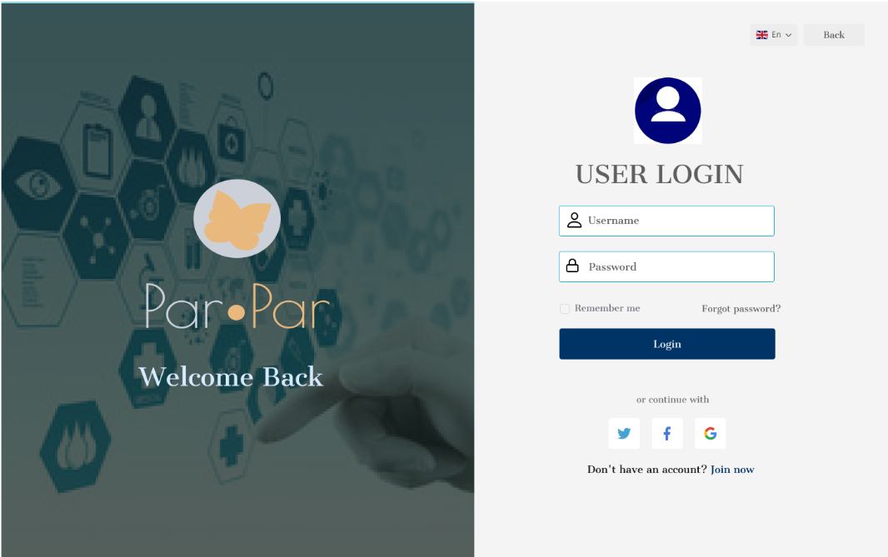
Simulation
Log-in

Slide 27
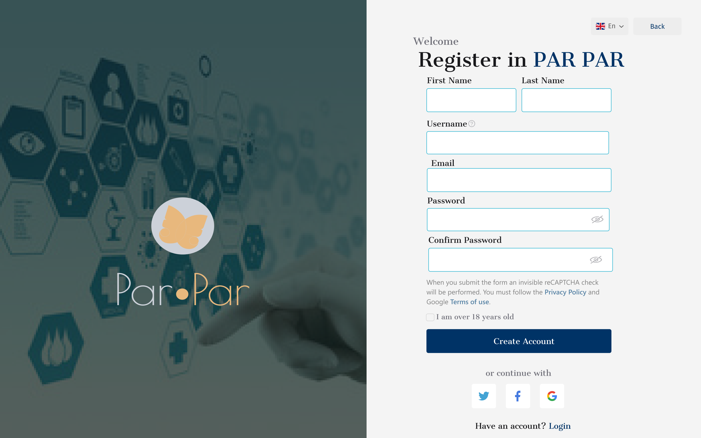
Simulation
Sign-up

Slide 28
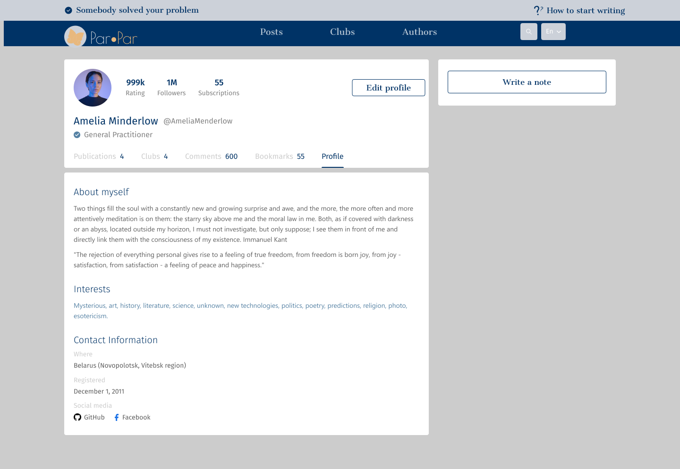
Simulation
Profile

Slide 29
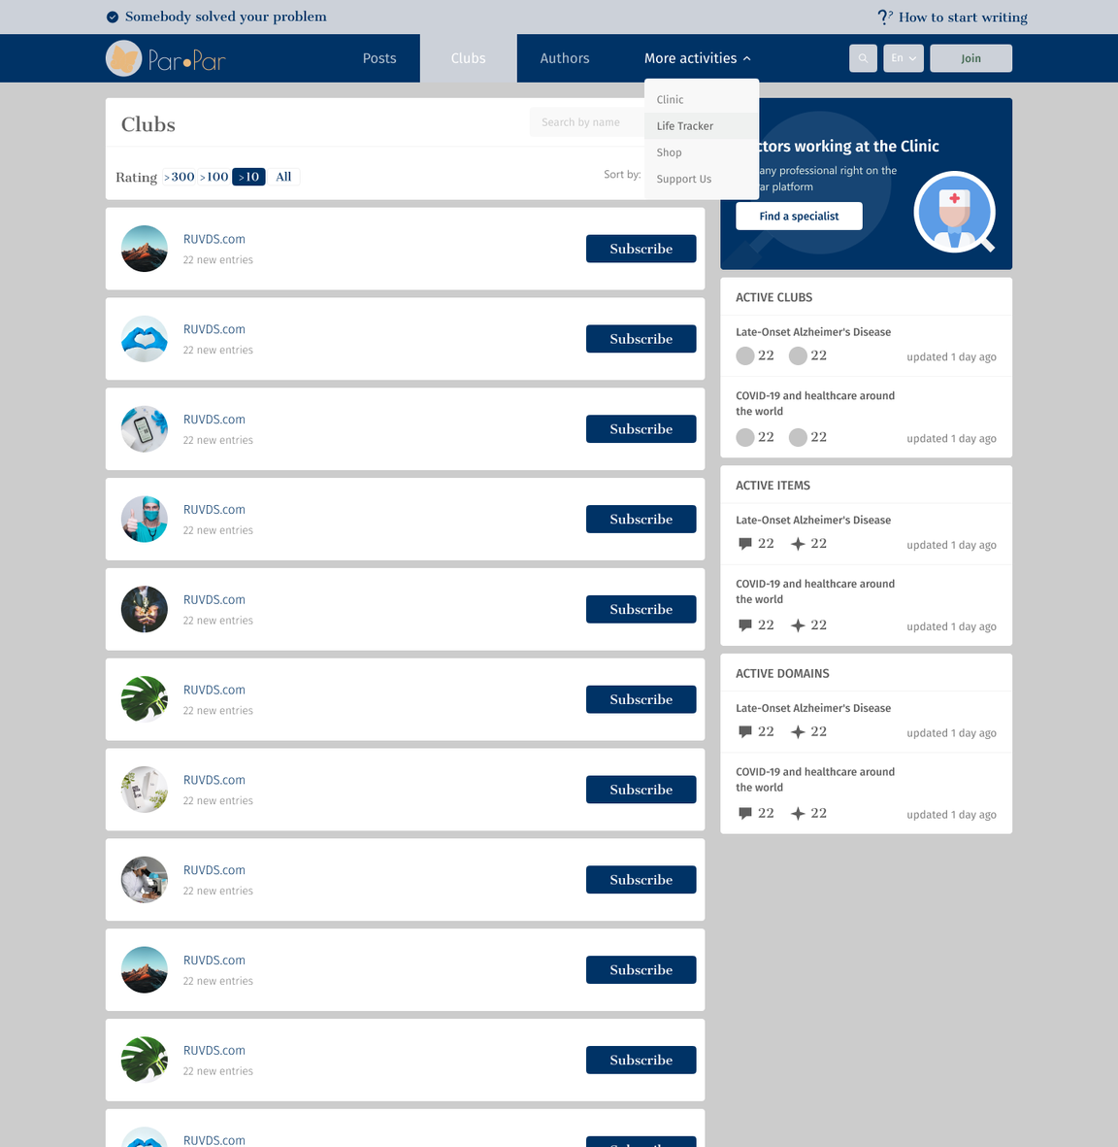
Simulation
Community
Page

Slide 30
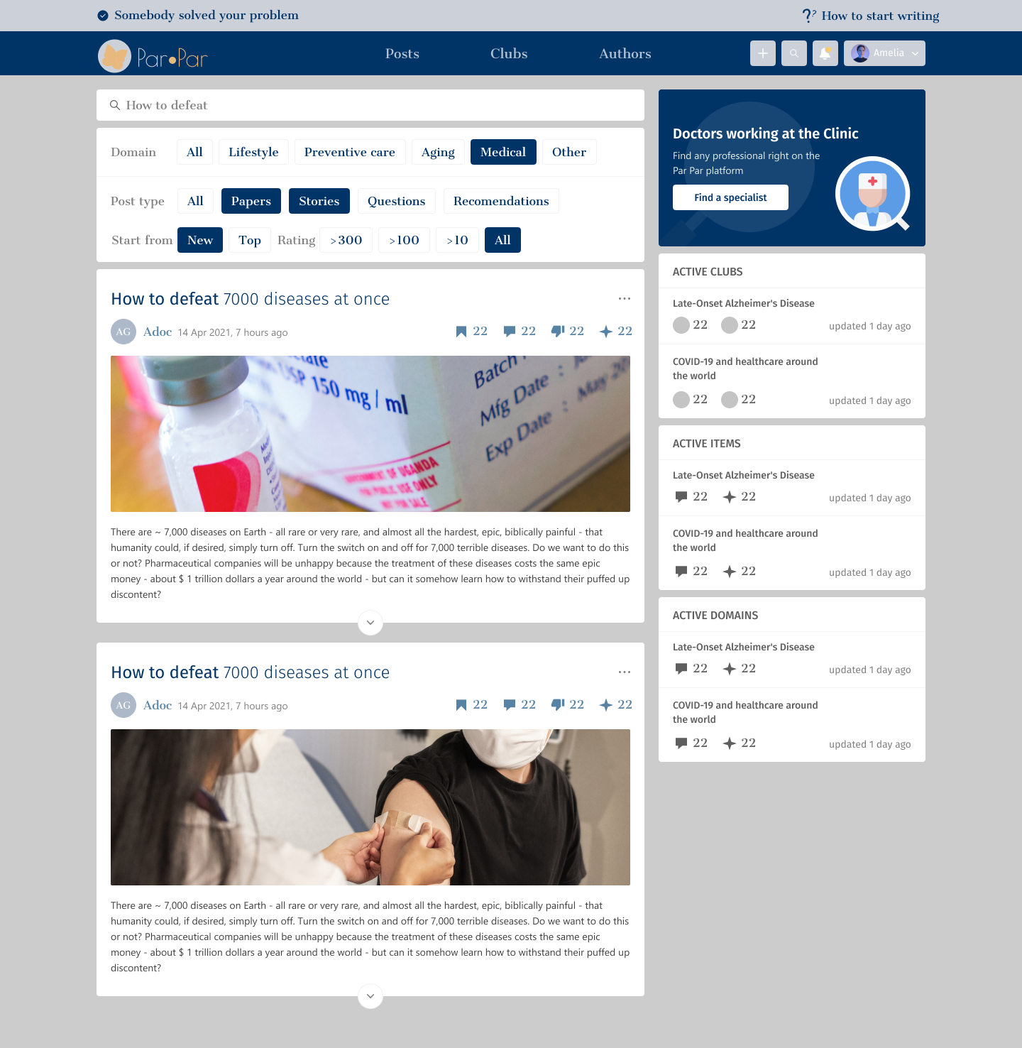
Simulation
Post +
Search

Slide 31
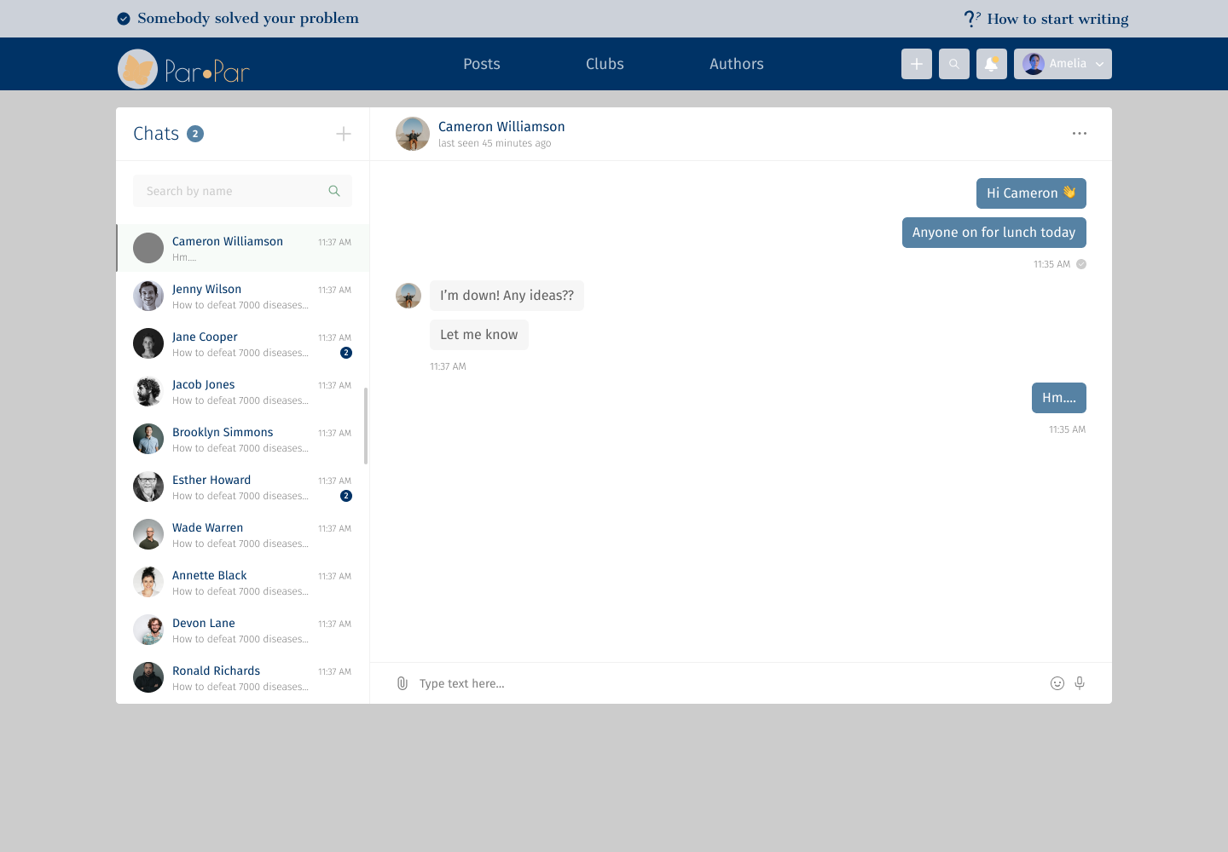
Simulation
Chat

Slide 32
Testing Plan
Test. number | Test description | Expected Result | Comments
1 | The system allows users to sign-up for the system | The user will be automatically logged in | Display a message “Successfully signed up”
2 | The system doesn't allow the user to sign-up with existing email | The sign-up failed, and an error message will be displayed | Display an error message “This email already exist”
3 | The system allows existing user to log in to the system | The user will be logged in, and the home page is loaded
4 | The system doesn't allow non existing user to log-in to the system | The log-in failed, and an error message will be displayed | Display an error message “This username is not found”
5 | The system doesn't allow a user to log in with a wrong password/empty details | The log-in failed, then an appropriate message will be displayed | The fields will be marked in red
6 | The system allows the user to add post | The post is loaded and displayed

Slide 33
Testing Plan
7 | The system doesn't allow the user to create an empty post | Failed to create a post | The required fields will be marked in red
8 | The system allows the user to delete post | The post is removed from community | The post is deleted and is not found anymore
9 | The system allows the user to update post | The post is updated and loaded again in the community
10 | The system allows the user to add comment | The comment is loaded and displayed
11 | The system doesn't allow the user to add an empty comment | Failed to create a comment and the required fields will be marked in red
12 | The system allows the user to delete comment | The comment is removed from the list | The comment is deleted and is not found anymore
13 | The system allows the user to update a comment | The comment is updated and loaded again list

Slide 34
THANK YOU FOR
LISTENING
TOP OF THE LINE
MEDICAL SERVICE PROVIDER

